Slide 1
Memos

Slide 2
Memos are an important part of on-the-job communication

Slide 3
Memos and E-mails
Differences and similarities in following terms:
destination
format
audience
topics
tone
speed or delivery time
attachments
length
security

Slide 4
Purpose of writing a Memo
Documentation
Cover/transmittal
Confirmation
Procedures
Recommendations
Feasibility
Status
Directive (delegation of responsibilities)
Inquiry

Slide 5
To request for action or information
To explain to the reader something that is not understood
To announce new products, procedures or anything else
To confirm the details of a meeting, conversation, or telephone call
To suggest solutions to business problems
To report the details of a project at regular intervals

Slide 6
Criteria
Memo ID lines
Introduction
Discussion
Conclusion
Audience recognition

Slide 7
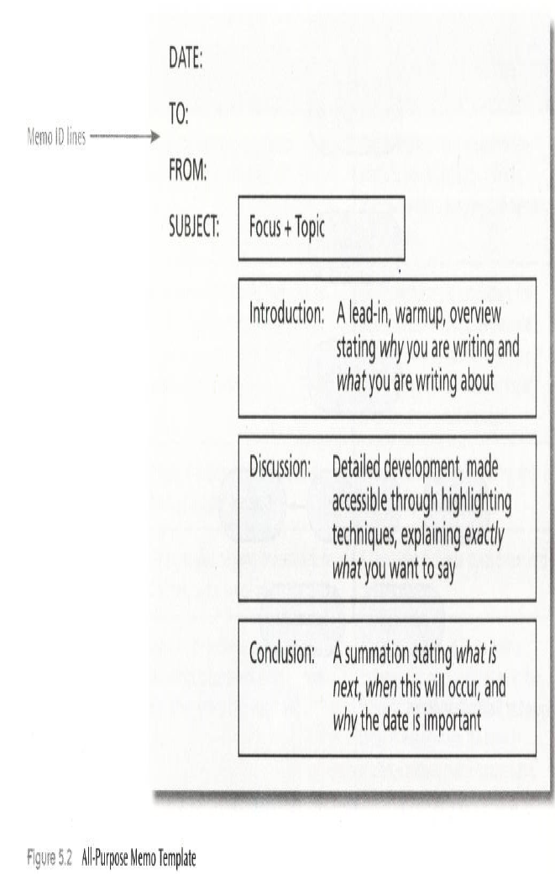

Slide 8
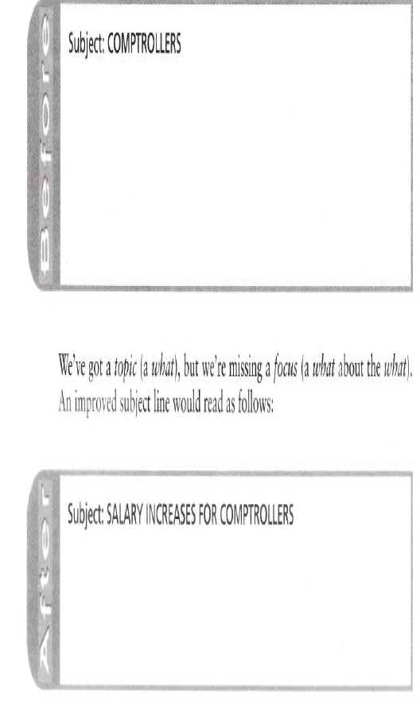

Slide 9
Subject lines
PERMISSION TO CHANGE PROCEDURE
REQUEST FOR FOUR MACHINES
DETAILS OF TRAINING PROGRAMME
TERMINATION OF SERVICES
ARRANGEMENTS FOR THE CONFERENCE

Slide 10
Introduction
In the third of our series of quality control meetings this quarter, I’d like to get together again to determine if improvements have been made.
As a follow-up to our phone conversation yesterday (16/8/12), …?

Slide 11
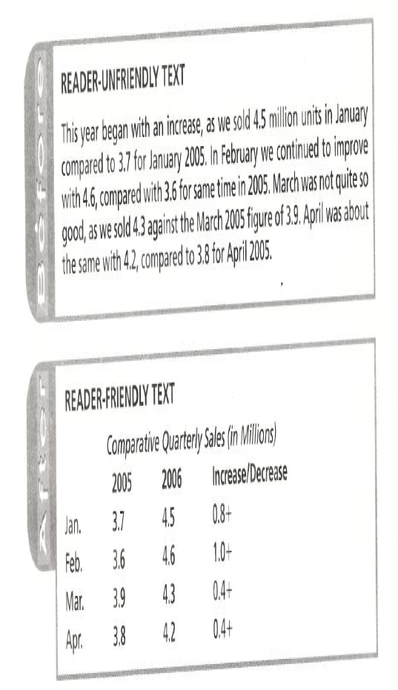

Slide 12
Conclusion
Conclude your memo with a complimentary close or a directive close.

Slide 13
Effective Memo Checklist
Have you used the correct memo format?
Is your subject line correct?
Is it typed in all caps?
Does it contain a topic and a focus?
Does your introduction tell why you are writing and what you are writing about?
Does the body explain exactly what you want to say?

Slide 14
Does the conclusion tell what’s next, providing a complimentary or a directive close?
Is your page layout reader-friendly?
Is your writing style concise?
Is your writing clear?
Have you written appropriately to your audience?
Are errors eliminated?

Slide 15
Style
Use simple words, readable sentences, specific detail, and highlighting technique.
Strive for an informal, friendly tone
Write as you would like to be written to.
Recognize audience

Slide 16
After:
How do you get service under the Emissions Performance Warranty? To get service under this warranty, take your car to the dealer as soon as possible after it has failed an EPA-approved test. Be sure to bring along the document that shows your car failed the test.

Slide 17
Unfriendly Vs Friendly tone
Before – We will have a meeting next Tuesday, Aug 20,2012. Exert every effort to attend this meeting. Plan to make intelligent comments regarding the new quarter projections.
After – Let’s meet next Tuesday(Aug 20,2012).Even if you’re late, I’d appreciate your attending. By doing so you can have an opportunity to make an impact on the new quarter projections. I’m looking forward to hearing your comments.

Slide 18
Use of Pronoun
Pronoun
Focus
You, Your (reader’s self worth)
We, Us, Our (camaraderie and group involvement)
I,Me, My (writer’s involvement, egocentricity
The reader
The team
The ego

Slide 19
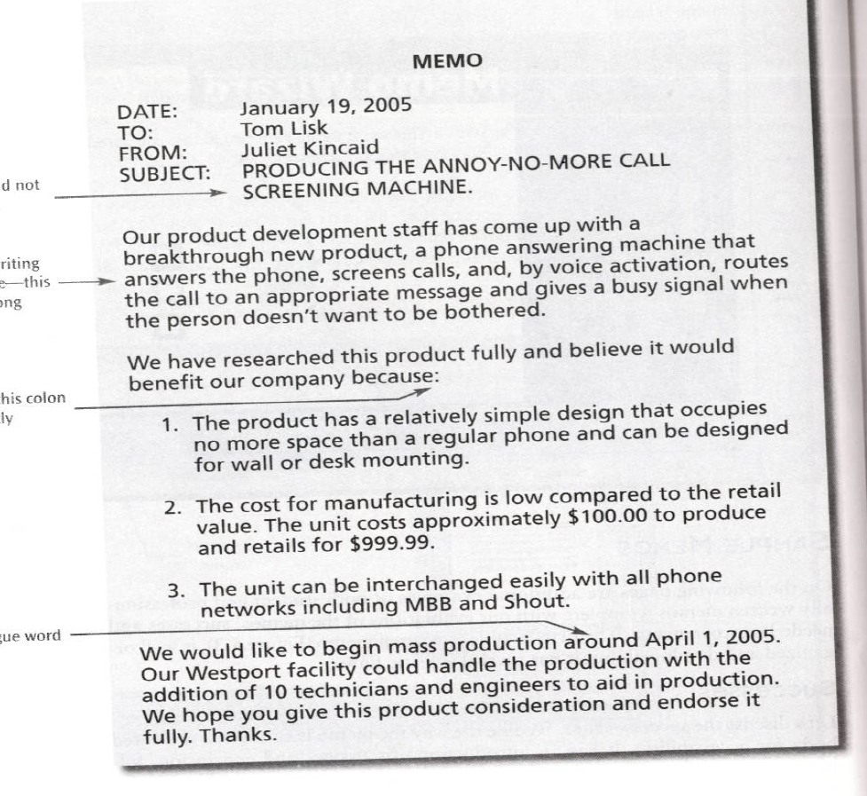

Slide 20
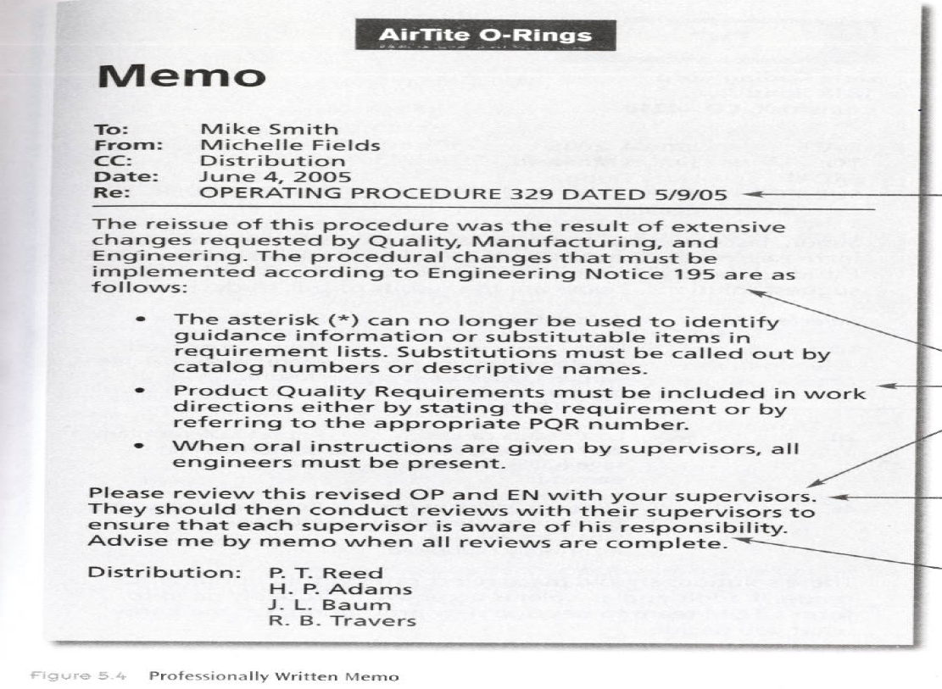

Slide 21
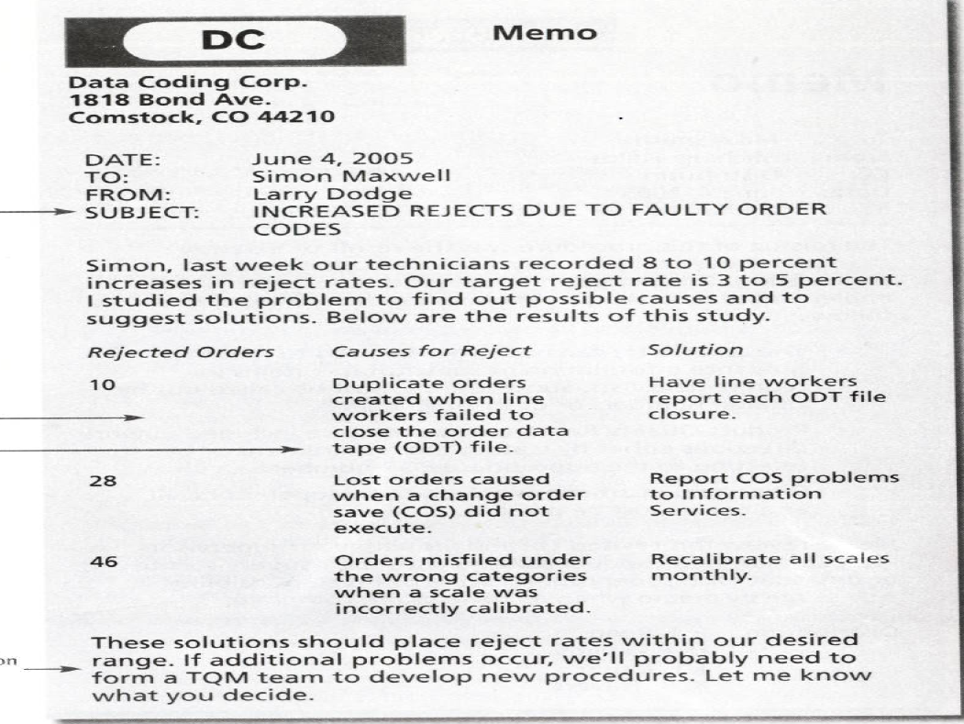

Slide 22
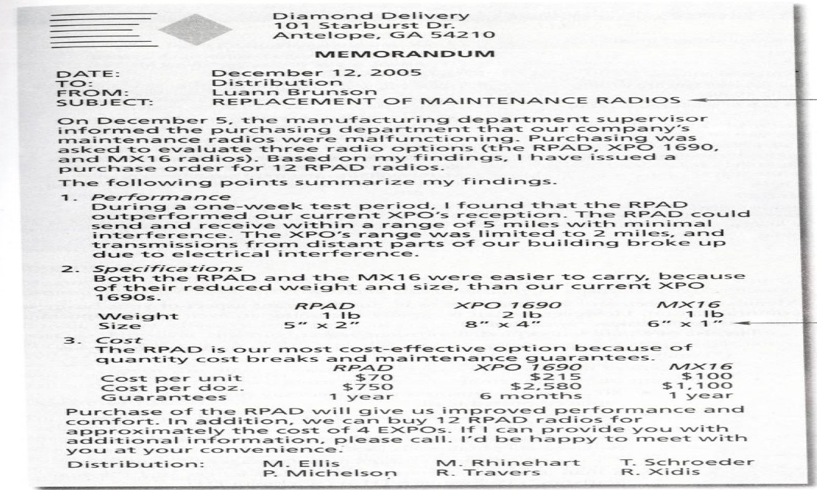

Slide 23
Question
Write a memo or e-mail on one of the following topics. To do so, first prewrite(using mind mapping or brainstorming). Then write a draft, and finally rewrite(revising your draft).
Your work environment is experiencing a problem(with scheduling, lay-offs, turnover, production, quality, morale, etc.). Your boss has asked you to write a memo providing your response.

